Slide 1
Unified mentor internship project presentation
BY
ANIMESH DUTTA
POSITION : DATA ANALYST INTERN
INTERNSHIP ID : UMID01052533819
2 MONTHS INTERNSHIP
INTERNSHIP DURATION : 15/05/2025 -15/07/2025

Slide 2
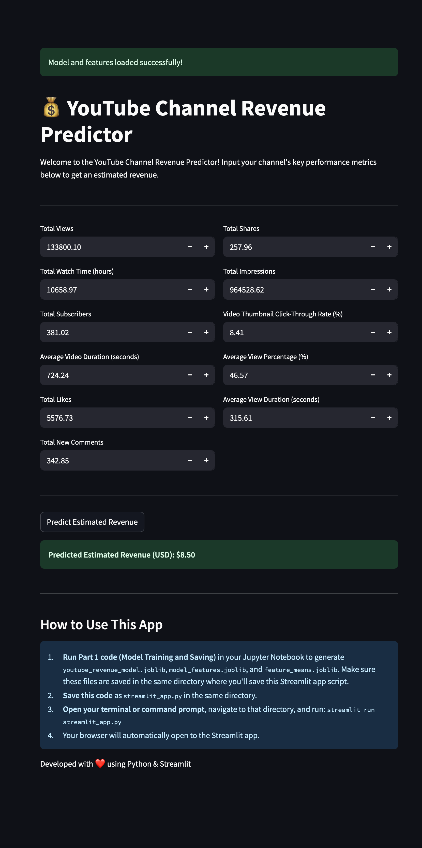
Unlocking Youtube channel performance secrets

Slide 3
contents
Introduction
Project objectives
Tools and technology used
Methodology ( steps performed and outputs )
Data visualization and insights
conclusion

Slide 4
introduction
This project analyses YouTube channel performance data to understand the key metrics that drive channel growth and revenue.
It culminates in the development of a predictive model to estimate YouTube channel revenue based on various performance indicators.
Gain insights into YouTube analytics and leverage machine learning to forecast channel earnings.

Slide 5
Project objectives
perform comprehensive data cleaning and preprocessing on the raw YouTube analytics dataset.
conduct Exploratory Data Analysis (EDA) to identify patterns, trends, and correlations among different performance metrics.
determine the most influential factors contributing to YouTube channel revenue.
build a robust machine learning model capable of accurately predicting a YouTube channel's estimated revenue (USD) based on its performance metrics.
provide a tool for content creators to estimate potential earnings and optimize their strategy.

Slide 6
Tools and technologies used
Programming Language: Python
Platform used : visual studio code and jupyter notebook
Data Manipulation & Analysis:
pandas: For efficient data loading, cleaning, and manipulation.
NumPy: For numerical operations and array handling.
Data Visualization:
matplotlib.pyplot: For creating static and customizable plots.
seaborn: For generating aesthetically pleasing statistical graphics.

Slide 7
Tools and technologies used
Machine Learning:
scikit-learn (sklearn): For data preprocessing (scaling, encoding), model selection training, and evaluation.
joblib: For saving and loading the trained machine learning model and feature lists.
tensorflow.keras (if you used a neural network): For building and training deep learning models.
Web Application (for deployment):
Streamlit: For creating an interactive web application that allows users to input metrics and get real-time revenue predictions.

Slide 8
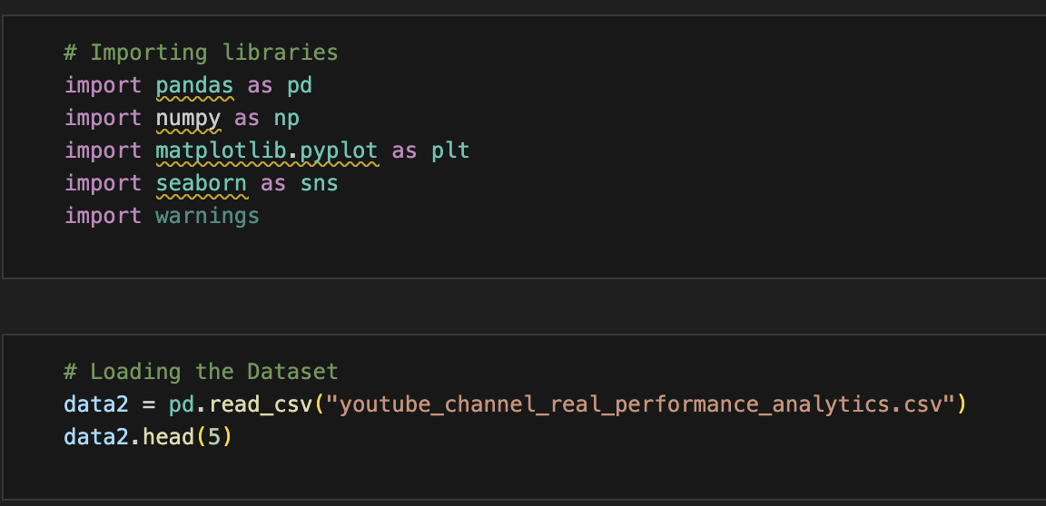
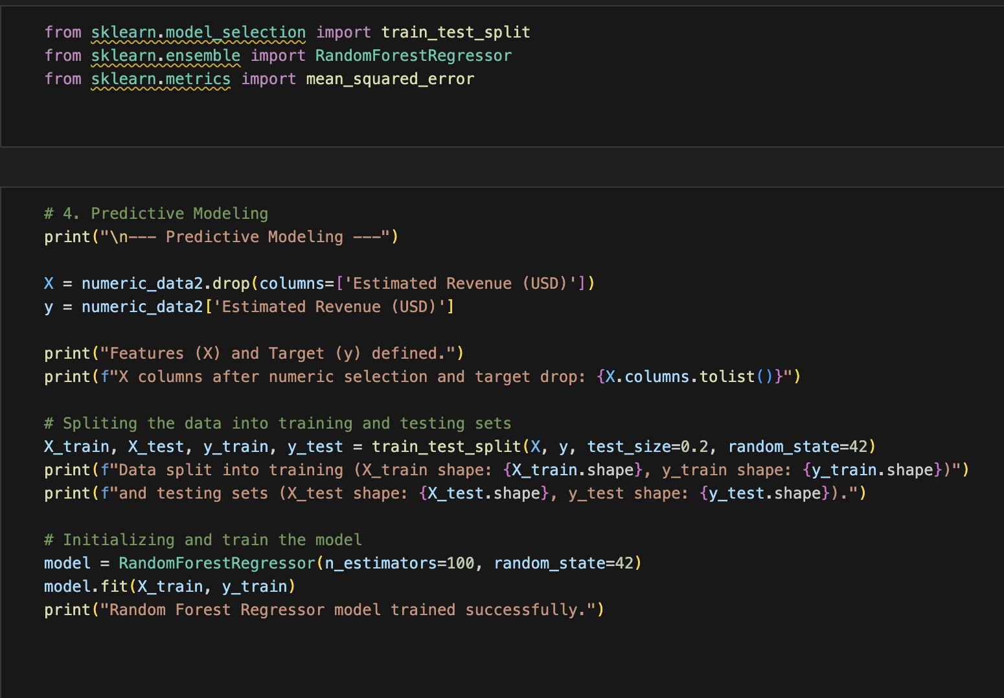
Code snapshots
IMPORTING LIBRARIES AND LOADING THE DATASET
PREDICTION MODELLING AND MODEL TRAINING BY USING FRAMEWORKS

Slide 9
METHODOLOGY
1. Data Collection:
The dataset youtube_channel_real_performance_analytics.csv was used, containing a wide array of metrics related to video performance, audience engagement, and monetization.
2. Data Cleaning & Preprocessing:
Missing Values: Checked for and handled any missing values.
Data Type Conversion: Converted Video Publish Time to datetime objects for time-based analysis and feature engineering.

Slide 10
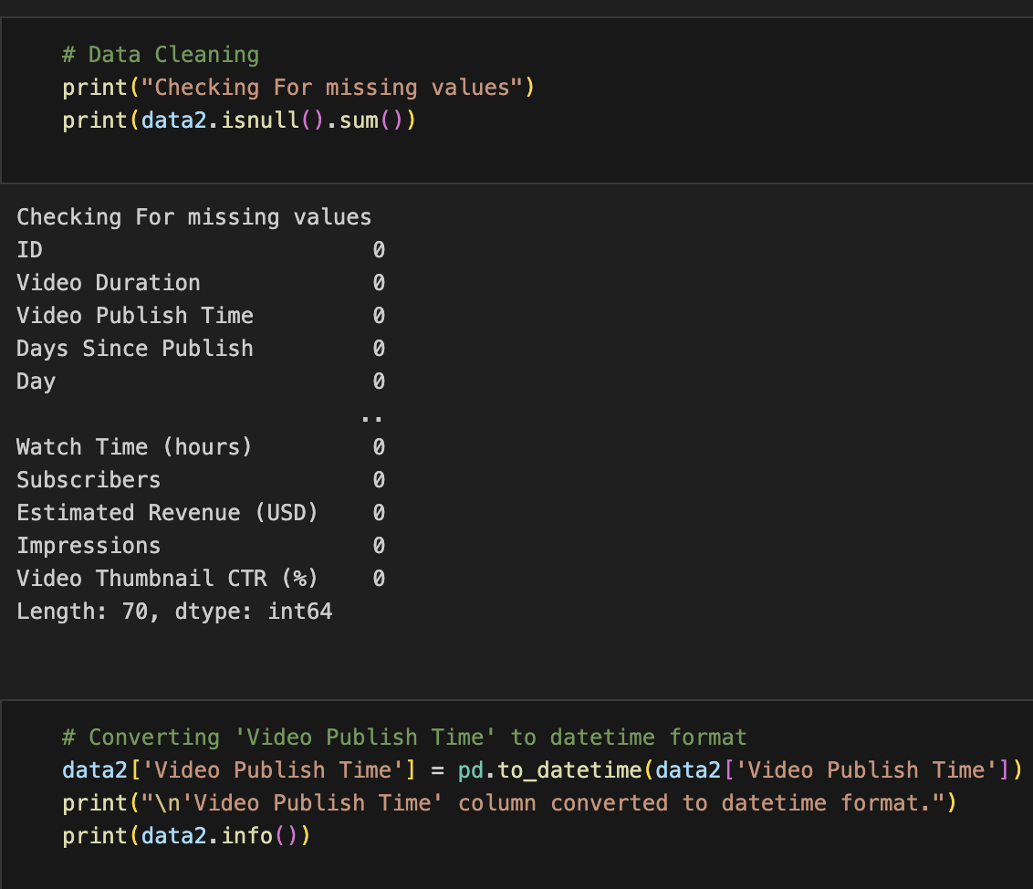
Data cleaning and data type conversion snapshot

Slide 11
Model Development & Training:
Model Selection: random forest regressor model is selected
Data Splitting: The dataset was split into training and testing sets to evaluate the model's performance on unseen data.
Model Training: The selected model was trained on the pre-processed training data.
Model Saving: The trained model, along with the list of features and their means (for Streamlit app input handling), was saved using joblib for later deployment.

Slide 12
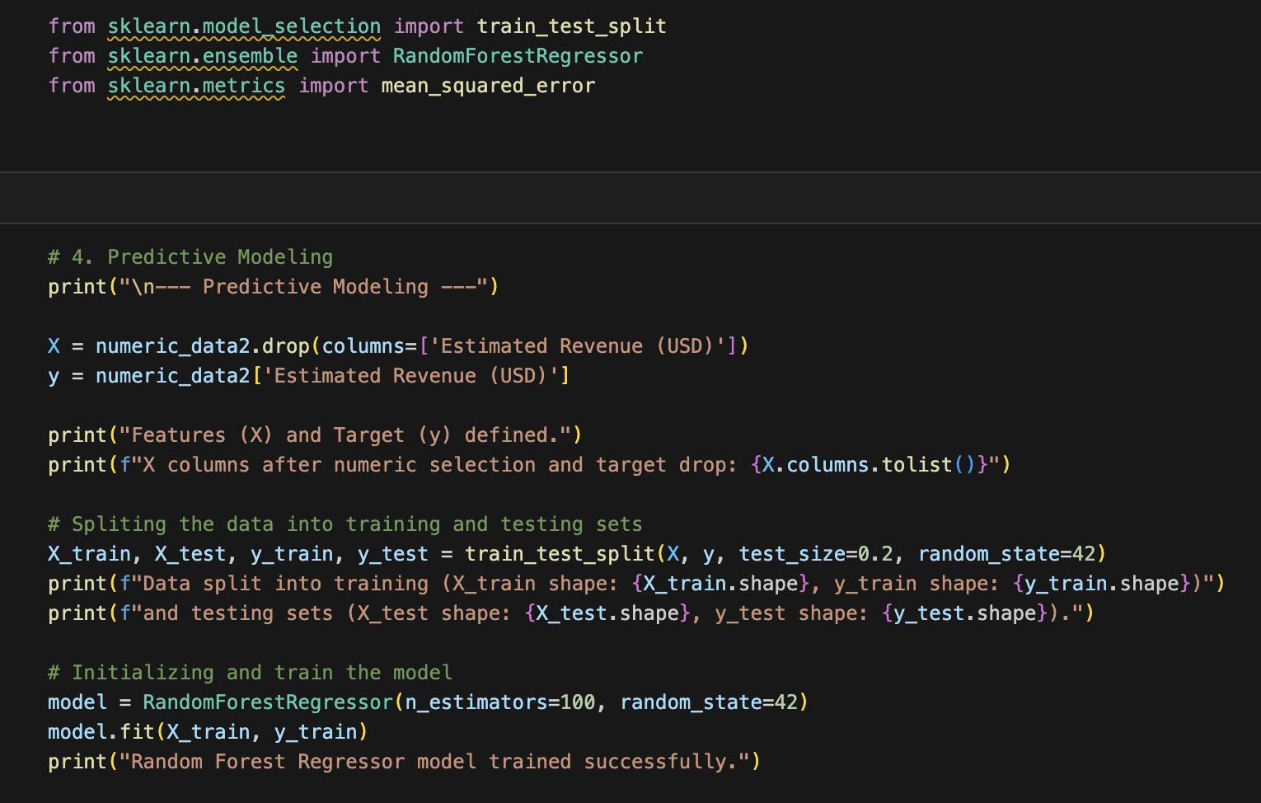
Predictive modeling and model training snapshot

Slide 13
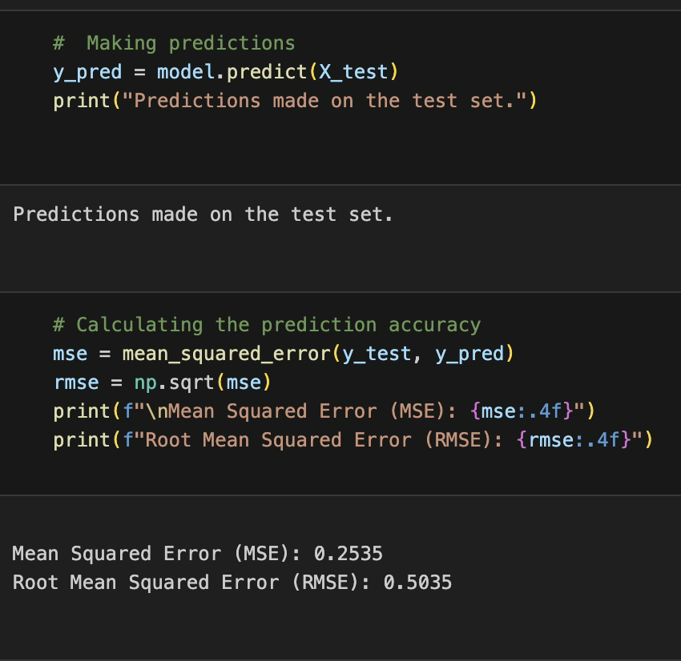
Model evaluation :
The model's performance was assessed using metrics such as Mean Squared Error (MSE) and Root Mean Squared Error (RMSE) to quantify the accuracy of revenue predictions.
SNAPSHOT CODE FOR MAKING PREDICTION AND CALCULATION OF THE PREDICTION ACCURACY

Slide 14
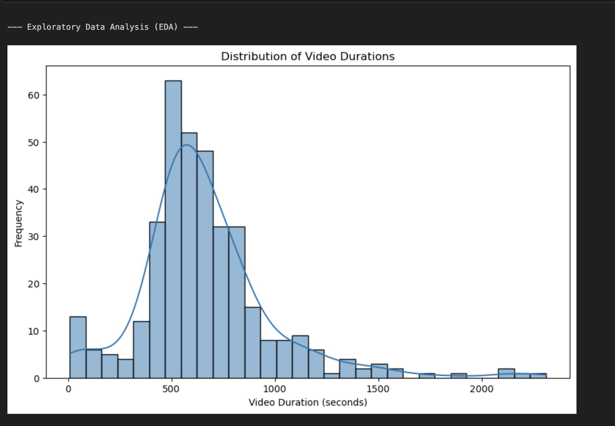
DATA VISUALIZATION AND INSIGHTS
Distribution of Estimated Revenue
A histogram showing the frequency of videos across different duration ranges. This helps understand the typical length of content on the channel.

Slide 15
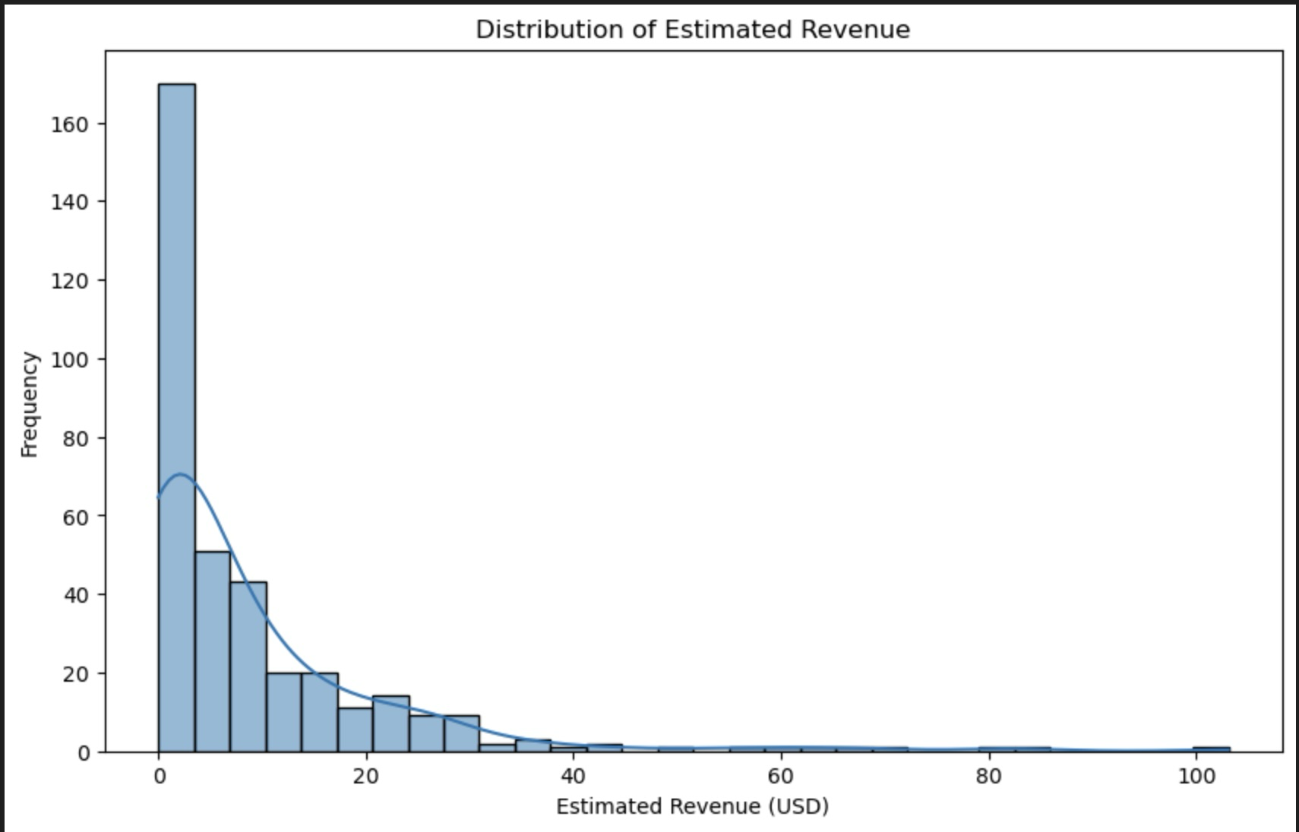
DATA VISUALIZATION AND INSIGHTS
Distribution of estimated revenue
This histogram shows how frequently different estimated revenue amounts occur in the dataset. The x-axis represents the Estimated Revenue (USD) and the y-axis shows the Frequency (how many channels fall into that revenue range). We can see that most channels have lower estimated revenue, with fewer channels generating very high revenue, indicating a right-skewed distribution.

Slide 16
DATA VISUALIZATION AND INSIGHTS
Youtube channel revenue predictor
Streamlit based YouTube channel revenue predictor It allows users to input various performance metrics of a YouTube channel (like views, watch time, subscribers, etc.) and then utilizes a pre-trained machine learning model to provide an estimated revenue in real-time. Essentially, it's a user-friendly interface to demonstrate and use your predictive analytics model for YouTube performance.

Slide 17
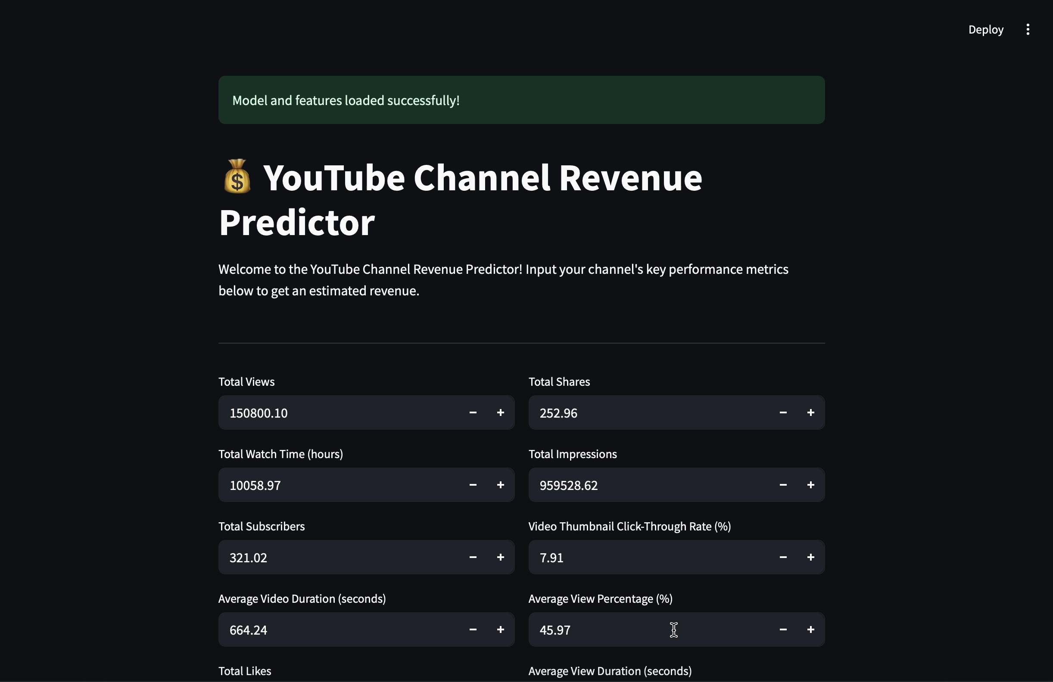
DATA VISUALIZATION AND INSIGHTS
Youtube channel revenue predictor

Slide 18
conclusion
Successfully developed a machine learning model to predict YouTube channel revenue, providing content creators with a valuable tool for strategic planning.
Identified that metrics such as Views, Watch Time (hours), Subscribers, Likes, and Impressions are highly correlated with and influential in determining estimated revenue.
The analysis provides actionable insights for optimizing content strategy, focusing on engagement metrics and video characteristics that maximize earnings.

Slide 19
The thankyou note
I am truly grateful towards unified mentor for giving me this wonderful opportunity to work as a data analyst intern for this past 2 months, I have learned about many concepts that will be essential for my data analyst journey in coming future. The detailed and full projects of mine will be provided in the git hub link below.
Project : Unlocking YouTube channel performance secrets

Slide 20
thankyou

